Slide 1
Digital marketing skills development workbook template

Slide 2
How to use this template using the GROW model
You can use this careers and skill development workbook template to summarize your personal aspirations, or it can be used as part of an employee personal development process as explained in our employee development learning path for premium members.
An example of a completed template is shown on the next slide with a blank example to complete based on responses to the different part of the GROW model: Goal, Reality, Options and Way forward.
Read the prompt questions then write a response in the area provided.
Use the ‘reality check’ questions to refine how the ideas will be translated into actions.
Once you have completed the 4 sections, use your responses to complete the blank plan summary sheet.
The plan summary sheet should be referred to during progress meetings and feedback sessions.

Slide 3
Individual Development Plan: Jo Sample
Plan start date: 01/04/2025
Plan finish date: 01/04/2026
My goal is to increase my knowledge and skills across all digital marketing channels so I am in a good position to apply for a promotional position in two years.
Business goal match:
As the business grows there will be opportunities for team expansion which will require new team leads. Jo’s goal is aligned to the overall business direction.
My current reality:
I am very successful in my current role and often take on extra responsibilities around administration and other general tasks. When I hear people talking about other marketing channels, such as email and social media, and I want to be able to know how to use these to support a campaign.
Manager comments:
At Jo’s last performance appraisal, she rated highly, and she indicated a desire to take on additional responsibilities. She has done this but, in order to progress further she needs to understand how each channel works and how they are integrated into a unified campaign. I believe she has the capacity to gain these skills, but it will require consistent, dedicated effort to achieve her goal.
My options:
Work through the Smart Insights Learning Paths
Attend webinars and listen to podcasts
Join professional groups on LinkedIn
Attend professional networking sessions and events
Professional reading
Manager comments:
I agree with Jo’s options. She will be able to monitor her progress through the Smart Insights Dashboard and I will be able to see progress as well, offering support where needed.
Progress summary: 15/05/2025
Working steadily through the Learning Paths
Campaign planning – 100%
RACE Practical Digital Strategy – 45%
Has attended 2 webinars
Progress summary: (DD/MM/YYY):
My way forward:
I will commit to completing one Learning Path per week and discuss how these skills can be implemented into my role.
I will make time with the current team leaders to talk about how they manager their time.
The organisation can support me by allowing me one hour per week to complete the learning in work time.
Manager comments:
These commitments will be monitored via the dashboard and during progress and feedback sessions. I am committed to allowing Jo one hour per week to fully focus on learning. She is encouraged to book a quiet room to do this away from distractions.
Progress summary: 15/05/2025
My work oad has increased with the resignation of one of the team. I have renegotiated the timeline for completion with my manager to take this into account.
Progress summary: (DD/MM/YYY):
Progress reviews and feedback sessions:
Progress review meetings will occur every three weeks.
Feedback will be provided by my manager on a regular, unscheduled basis.
Final review comments: 26/06/2020
I have successfully completed 4 learning paths that are most relevant to my current role and to support her progression toward applying for a promotional position. It has been difficult for me to find time to implement what I have learned but this will form the basis of my next learning plan.

Slide 4
Individual Development Plan:
Plan start date: DD/MM/YYYY
Plan finish date: DD/MM/YYYY
My goal is to
Business goal match:
My current reality:
Manager comments:
My options:
Manager comments:
Progress summary: DD/05/2020
Progress summary: DD/MM/YYY
My way forward:
Manager comments:
Progress summary: DD/MM/YYY
Progress summary: DD/MM/YYY
Progress reviews and feedback sessions:
Final review comments: DD/MM/YYYY

Slide 5
Smart Insights premium resources to help you
These are the best places to find resources to help your skills development:
Learning Path courses - Start with the RACE Practical Digital Strategy Learning Path or choose modules for individual channels or developing AI Skills
All resources pages – Use these to apply your skills to real-world projects - you can select from over 190 templates and guide downloads grouped by toolkits for strategy, analytics and different channels
See our membership benefits page for a summary of how we help our members

Slide 6
GROW: Goal
Aim: Create a simple goal statement which is SMART.
Tools to help formulate your goal: List of questions for employees
The Golden Circle
BHAG

Slide 7






Goal: What do you want to achieve?
Questions for employees
Reality check
Where do you see yourself in one, five and 10 years?
Is the goal specific enough to be actionable?
What skills do you want to develop next?
Can progress be tracked easily?
What current tasks and projects do you enjoy the most?
Is the goal attainable and within reach?
What future opportunities and projects excite you?
Does the goal make sense for where the team member is and where they want to be?
What kinds of work experiences do you want to have?
Is the time frame realistic?
What do you hope to create or what kind of impact do you want to make?
What goals would you set set if you were in their position?

Slide 8
Start with the ‘Why’
For anyone on their career journey, it is important to clarify and articulate a purpose because this can act as a motivational force to keep going through time and reach your goals. Best-selling author Simon Sinek developed the Golden Circle Model which talks about the “why”. Sinek researched great leaders on how they inspire people to take action and companies that defy what is possible to exceed expectations. He found that these great leaders always communicated and articulated their purpose very well. Most people when asked what they do, they talk about the how and the what but rarely people talk about the why. As a marketer, whether you are on the start of your career or at a later stage, it is always useful to clarify why you decided to take this journey.
My purpose is… XX

Slide 9
Do you have a BHAG?!
The acronym BHAG (pronounced “Beehag”) which stands for Big Hairy Audacious Goal is a term coined by authors Jim Collins and Jerry Porras in the book ‘Built to Last’. It is described as a long-term goal aimed at expanding the aspirations of an individual or organization.
My BHAG is… XX

Slide 10
My SMART development goal
Considering the questions on the previous slide, describe how you want to develop and then structure this goal in such a way that it is SMART that is, one that is Specific, Measurable, Attainable, Realistic, and Time-bound.
Example: I would like to be in a position to apply for a team leader role in the marketing team in two years.
My goal is…
XX

Slide 11
GROW: Reality
Aim: Create a
Tools to help you assess your current skills and situation
List of questions for employees
T-Shaped Marketer framework
SWOT reflection questions

Slide 12
Reality: What is the current situation?
Questions for employee
Reality check
How successful are you in your current role?
What skills, knowledge, or experiences does the employee need to make their goals happen?
What steps have you already taken to pursue your goals?
Do the steps they have already taken aligned to future directions?
What’s currently holding you back?
What requirements are missing? What are the gaps?
What knowledge, skills or experiences work in your favour?
How can the employee be a more competitive future candidate?
What are your current limitations or constraints?
Are there any other obstacles to attaining their goals?
What gaps in knowledge, skills or experiences are hindering your progress?
Are the employee’s current performance outcomes and competencies in line with their career ambitions?

Slide 13
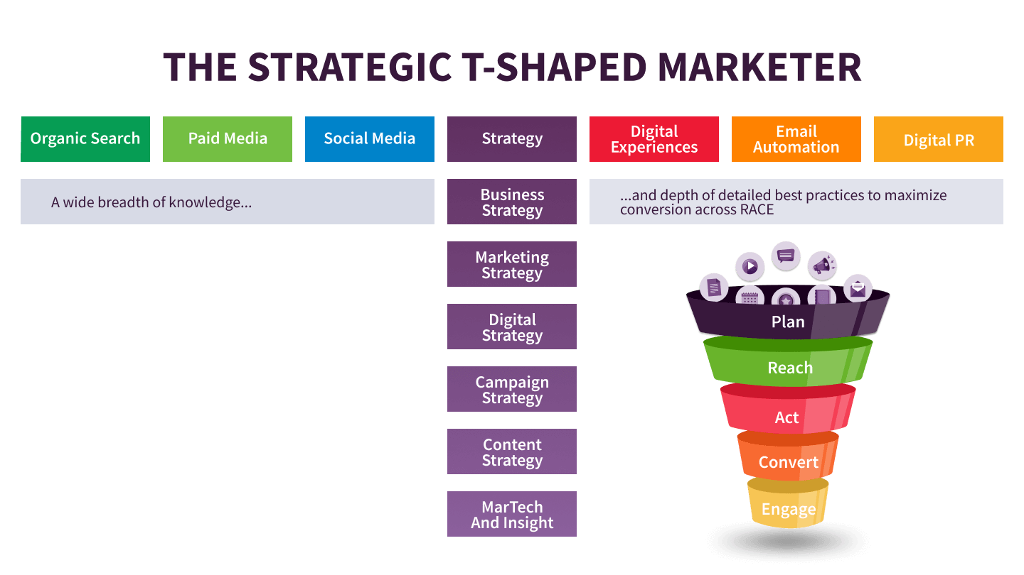
Review current and priority skills - particularly strategy skills which will be important for career progression
Source: Smart Insights – T-shaped marketer article

Slide 14
Current situation - Strengths
What are the areas you are excelling in?
What abilities and skills do you have that set you apart from your team?
What do other people you know say about you and see as your strengths?
What are you naturally good at (tasks, thinking, approach)?

Slide 15
Current situation - Weaknesses
• What types of tasks do you struggle with or avoid?
• Why would your boss select someone else to do a task over you?
• What would be the reasons that you may be rejected for a promotion or new job?
• What is your kryptonite (or chink in the armour)?
• What things are limiting you from progressing forward?

Slide 16
Current situation - Opportunities
• Which market trends fit well with the things you enjoy doing?
• What is the employer/market demand that meets the skills/knowledge you own or could easily acquire?
• Do you have transferable skills that could be used in other industry sectors?
• What are they ways you can raise your profile in the vertical you currently operate in?

Slide 17
Current situation – Opportunities (continued)
• What are the quick wins – do you have something that others are willing to pay a lot of money for?
• Are there other projects you could get involved within your organisation?
• Who are the people in your company that can help you progress?

Slide 18
Current situation - Threats
Which of your skills could go out of date quickly?
What do new marketers or external contractors have that you don’t?
What are the biggest threats facing the company you work for that will affect you?
What are the threats facing your industry that are going to be impact your role?
What is the impact of technology and automation on your role?
If you were made redundant, what would be your next move?

Slide 19
Current situation
Considering the evaluation on the previous slides, reflect honestly on your current reality as it will be difficult to reach your development goal without fully considering your starting point.
Example: I am very successful in my current role and often take on extra responsibilities around administration and other general tasks. Often, I hear people talking about other marketing channels, such as email and social media, and I want to be able to know how to use these to support a campaign.
My current reality…

Slide 20
GROW: Options
Aim: Create a list of options to develop skills of different types
Tools to help prepare your plans
List of questions for employees
RACE visual priority scorecards

Slide 21
Options: What choices do you have e.g. skills development, coaching?
Questions for employee
Reality check
What can you do right now to further develop the skills you need to reach your career goal?
What growth opportunities have you looked into or know about?
What assignments, projects, or experiences could you pursue?
What special projects could I assign you?
What are your networking or mentorship options?
Who could I introduce the employee to?
What has worked for you already? How could you do more of that?
Are there any cross-functional training opportunities?
What do you think you need to do to get closer to your goal?
Are there any relevant job openings, promotional opportunities, or business needs in the pipeline?
What is the first step you can take to achieve your goal?
What other learning opportunities or resources could you refer the employee to?

Slide 22
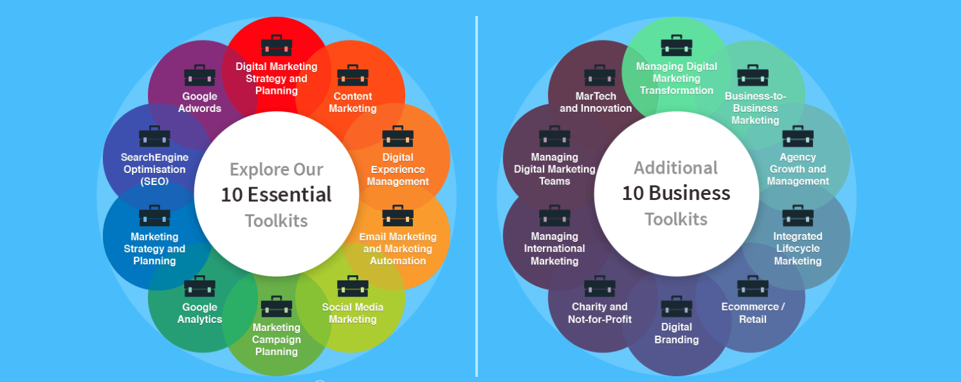
Select the most relevant Smart Insights toolkits
See all Toolkits included with membership

Slide 23
25 key RACE activities - visual priority scorecard
Plan
Strategy and planning
Reach Cust awareness
Act
Cust research
Convert
Cust purchase
Engage
Cust service
Key
DM effectiveness
Digital SWOT
KPIs: Market share
Media review
VQVC MoM/Y analysis
KPIs: Share, CPA
Customer journey
VQVC analysis
KPIs: Lead conversion
Lead nurture
Contact strategy
KPIs: MQL conversion
Customer onboarding
Email and web messaging
Priority to improve skills
Vision and objectives
Digital vision
Actionable dashboard
Search marketing
Gap analysis
Search strategy
Audience profiling
Lead analysis
Profiling strategy
Buyer-support
Customer self-
service applications
Customer experience
Loyalty strategy
KPIs: Digital NPS
Potential to improve skills
Lifecycle marketing
capabilities
DM strategy
AOP integration
90-day planning
Owned media
Digital PR
Social media
Content marketing:
Content audit
Content strategy
Personalization
Digital vision
Actionable dashboard
Customer service
Web self-serve
Chatbots
Below average
Capabilities
- priority
DM target marketing
Persona mapping Digital proposition
Paid media
Brand / Demand
Paid social
Landing pages
Engagement analysis
Optimization plan
CRO
CRO plan
90-day optimization
Email marketing
Contact strategy
Newsletter/Solus
Governance
Process support
SLAs and NPS
Acquisition plan
Always-on plan
90-day optimization
Campaign planning
Campaign process
90-day optimization
Multichannel selling
Assisted selling
Chatbot support
Social media
Contact strategy
Newsletter/Solus
You can use this visual summary across RACE to present where skills can be improved.
Key: NPS = Net Promoter Score. VQVC = Volume, Quality, Value, Cost measures. MoM/Y = Month on month or year
Notes:
These are our 25 recommended customer lifecycle marketing activities across RACE that we recommend are reviewed when creating digital marketing strategies.
For each part of RACE, we have identified 5 key activities that need to be managed across most types of businesses to take advantage of digital marketing opportunities.
These 25 activities are the best balance between the many digital marketing techniques available, while keeping it as simple as possible to give a checklist of what needs to be managed by in-house or external resources. They are based on our recommended always-on/inbound marketing activities when consulting on real-world projects to develop digital marketing strategies.
Note that social media and email marketing are relevant across RACE, but we cover them in our framework under Engage since they excel as customer communications.

Slide 24
Options
Using the questions on the previous slide, consider all of the possible options for reaching your developmental goals including training platforms, skills development sessions as well as coaching and mentoring. Also reference specific priority skills to acquire across RACE.
Example: I need to learn more about other aspects of marketing other than email. I have read some books and watched videos but it would be great to have some expert resource that links it all together. I get a lot from webinars and listening to podcasts as I can watch them when I have time.
Summary of my options…
List of priority digital marketing skills to acquire across RACE…

Slide 25
GROW: Way forward
Aim: Define a plan for how you move forward
Tools to help you define your next steps
List of questions for employees

Slide 26
Way forward: What action can you take?
Questions for employee
Reality check
What do you think you need to do right now?
Does the employee’s plan directly support their broader career goals?
How committed are you to achieving your goals?
Is the employee’s plan realistic and attainable?
What roadblocks are you expecting? How do you plan to deal with them?
What’s missing? Are there any steps you would add or change?
What resources will you need? What can the organization offer?
What resources do they need to be successful?
When are you going to start putting your plan into action?
How can I support them in achieving their goals?
What are three actions you can take this week?
Are the immediate actions reasonable?

Slide 27
Way forward
Using the questions on the previous slide, consider your commitment to development and establish a clear action plan for next steps.
Example: I will commit to completing one Learning Path per week and discuss how these skills can be implemented into my role. I will make time with the current team leaders to talk about how they manage their time. The organisation can support me by allowing me one hour per week to complete the learning in work time.
My commitment to improve in the identified time period is…
Commit from organization and colleagues to support skills development…

Slide 28
Progress reviews and feedback sessions
How often do you need to report back on progress?
How will you report back any difficulties you might be having?
Is your goal still achievable in the timeframe?
What successes have you had?
What are you struggling with? What support do you need?
What systems or processes are impacting on the plan?

Slide 29
Progress reviews and feedback sessions
These meetings are essential to understanding what’s going on for you and how that might be impacting on goal achievement. Use the questions on the previous slide to help determine the best schedule for you.
Example: Progress review meetings will occur every three weeks. Feedback will be provided by my manager on a regular, unscheduled basis. I will be ready to discuss my successes and difficulties when asked.
My progress and feedback schedule:

Slide 30
Smart Insights premium resources to help you
These are the best places to find resources to help your skills development:
Learning Path courses - Start with the RACE Practical Digital Strategy Learning Path or choose modules for individual channels or developing AI Skills
All resources pages – Use these to apply your skills to real-world projects - you can select from over 190 templates and guide downloads grouped by toolkits for strategy, analytics and different channels
See our membership benefits page for a summary of how we help our members

